Slide 1
Module 7.10 IP Security

Slide 2
IP Security
There are range of app-specific security mechanisms
eg. TLS/HTTPS, S/MIME, PGP, Kerberos, …
But security concerns that cut across protocol layers
Implement by the network for all applications?
Enter IPSec!

Slide 3
IPSec
General IP Security framework
Allows one to provide
Access control, integrity, authentication, originality, and confidentiality
Applicable to different settings
Narrow streams: Specific TCP connections
Wide streams: All packets between two gateways

Slide 4
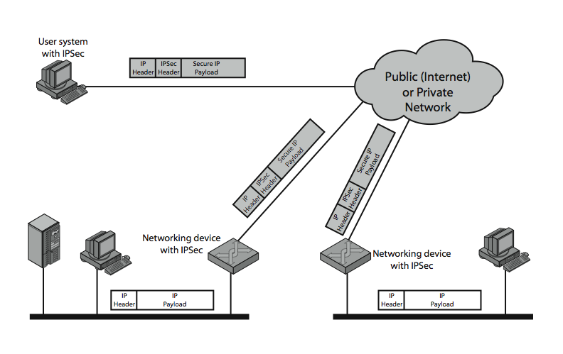
IPSec Uses

Slide 5
Benefits of IPSec
If in a firewall/router:
Strong security to all traffic crossing perimeter
Resistant to bypass
Below transport layer
Transparent to applications
Can be transparent to end users
Can provide security for individual users

Slide 6
IP Security Architecture
Specification quite complex
Mandatory in IPv6, optional in IPv4
Two security header extensions:
Authentication Header (AH)
Connectionless integrity, origin authentication
MAC over most header fields and packet body
Anti-replay protection
Encapsulating Security Payload (ESP)
These properties, plus confidentiality
Notes:
Not as robust: Can detect duplicates, but not lost or re-ordered…
• RFC 2401: An overview of a security architecture
• RFC 2402: Description of a packet authentication extension to IPv4 and IPv6
• RFC 2406: Description of a packet encryption extension to IPv4 and IPv6
• RFC 2408: Specification of key management capabilities

Slide 7
Encapsulating Security Payload (ESP)
Transport mode: Data encrypted, but not header
After all, network headers needed for routing!
Can still do traffic analysis, but is efficient
Good for host-to-host traffic
Tunnel mode: Encrypts entire IP packet
Add new header for next hop
Good for VPNs, gateway-to-gateway security

Slide 8
Replay Protection is Hard
Goal: Eavesdropper can’t capture encrypted packet and duplicate later
Easy with TLS/HTTP on TCP: Reliable byte stream
But IP Sec at packet layer; transport may not be reliable
IP Sec solution: Sliding window on sequence #’s
All IPSec packets have a 64-bit monotonic sequence number
Receiver keeps track of which seqno’s seen before
[lastest – windowsize + 1 , latest] ; windowsize typically 64 packets
Accept packet if
seqno > latest (and update latest)
Within window but has not been seen before
If reliable, could just remember last, and accept iff last + 1

